Slide 1
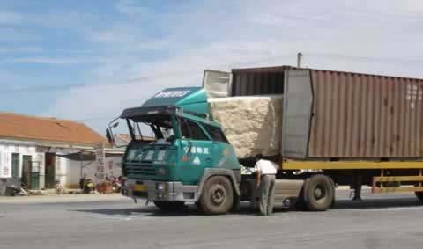
Momentum
http://phet.colorado.edu/en/simulation/forces-1d

Slide 2
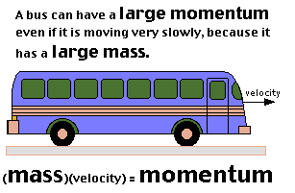
a property of any moving object that depends on its mass and velocity (or speed if you don’t worry about direction)
must know both of these in order to calculate momentum
normally we will use g(m/s) or kg(m/s) as a unit of measurement
Bill Nye 2:06

Slide 3
Momentum formula
ρ = mv or ρ = m·v
or ρ = m ^{x} v or ρ = m(v)
ρ = momentum
m = mass
v = velocity

Slide 5
Example problem
A ball has a mass of 2.5 kg and a velocity of 6.0 m/s heading North. Calculate its momentum.
given formula set up problem answer w/ unit of measurement
m=2.5kg p=mv
v=6.0m/s
2.5kg(6.0m/s)
15.0 kg(m/s)
How would you label the answer if the mass was
2.5 g and the velocity 6.0 km/hr?
15.0 g(km/hr)

Slide 6
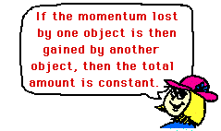
Conservation of momentum
the momentum of an object can not disappear
in a collision:
some or all of the momentum from the 1st object is transferred to the 2nd object
the momentum before and after is the same
(friction may take away some energy)
Phet - collisions

Slide 7
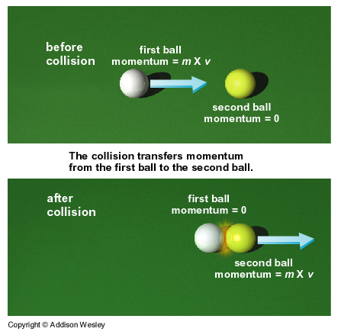

Slide 8
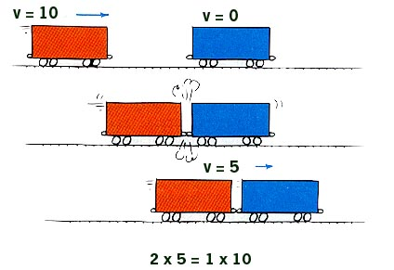

Slide 9
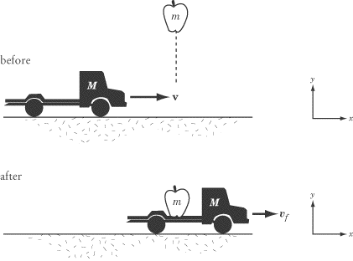
Conservation of Momentum video (1:37)

Slide 11
Crazy kid Youtube Video

Slide 12
Problem Solving #1 (write this down)
A 6 kg fish swimming at 1 m/sec swallows a 2 kg fish that is at rest. Find the velocity of the fish immediately after “lunch”.
System is both fish, so …..
net momentum _{before} = net momentum _{after}
((mv _{big fish}) + (mv_{small fish}))_{before} = (m _{big fish}+ m_{small fish})(V_{both)after}
(6 kg)(1 m/sec) + (2 kg)(0 m/sec) = (6 kg + 2 kg)(v_{after})
6 kg.m/sec = (8 kg)(v_{after})
v_{after} = 6 kg.m/sec / 8 kg
8 kg
v_{after} = ¾ m/sec
v_{after} =

Slide 13
Problem Solving #2
Now the 6 kg fish swimming at 1 m/sec swallows a 2 kg fish that is swimming towards it at 2 m/sec. Find the velocity of the fish immediately after “lunch”.
System is both fish, so….
total momentum _{before} = total momentum _{after}
(total mv)_{before} = (total mv)_{after}
((mv _{big fish}) + (mv_{small fish}))_{before} = (mv _{big fish}) + (mv_{small fish}))_{after}
(6 kg)(1 m/s) + (2 kg)(-2 m/s) = (6 kg + 2 kg)(v_{after})
6 kg.m/sec + -4 kg.m/sec = (8 kg)(v_{after})
v_{after} = 2 kg.m/sec / 8 kg
8 kg
v_{after} = ¼ m/sec
v_{after} =

Slide 14
Problem Solving #3 & #4
Now the 6 kg fish swimming at 1 m/sec swallows a 2 kg fish that is swimming towards it at 3 m/sec.
(net mv)_{before} = (net mv)_{after}
(6 kg)(1 m/sec) + (2 kg)(-3 m/sec) = (6 kg + 2 kg)(v_{after})
6 kg.m/sec + -6 kg.m/sec = (8 kg)(v_{after})
v_{after} = 0 m/sec
Now the 6 kg fish swimming at 1 m/sec swallows a 2 kg fish that is swimming towards it at 4 m/sec.
(net mv)_{before} = (net mv)_{after}
(6 kg)(1 m/sec) + (2 kg)(-4 m/sec) = (6 kg + 2 kg)(v_{after})
6 kg.m/sec + -8 kg.m/sec = (8 kg)(v_{after})
v_{after} = -1/4 m/sec

