Slide 1
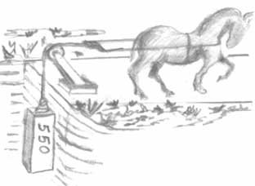
Work and Power

Slide 2
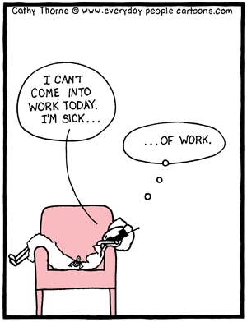
F.A.
Students do work

Slide 3
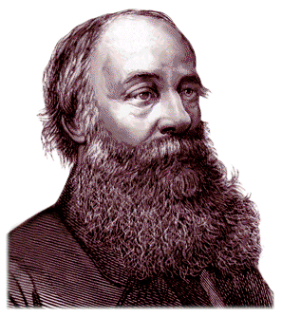
Work
is the transfer of energy that results from applying a force over a distance
  if nothing moves, no work was done
unit of measurement is the Joule (J)
  used to be a Newton-meter (N•m)

Slide 4
Work formula
W = F · D
W = work
F = force
D = distance

Slide 6
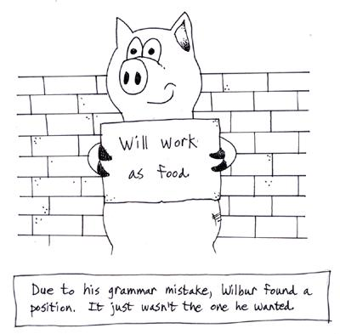

Slide 7

Example problem
How much work is done when a 60 Newton dog is lifted up7 meters?
given formula set up problem answer w/ unit of measurement
F= 60 N W=FD 60N(7m) 420 Joules
D= 7 m
*Could have put N(m) instead of Joules– same thing.

Slide 8
There are different “ways” to get work done, but regardless, the work must be done.
  Work = Force x Distance
  Work = Force x Distance
Notes:
Have student pull a mass up two different ramps with spring scale.

Slide 9
What is same? The difference?
3 m
Work is the same.
3 m
This one would require less effort

Slide 10
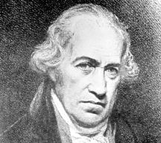
Power
how “fast” work is being done
unit of measurement is the watt (W)
  James Watt, a Scottish engineer, invented the steam engine.
  James Watt explained power as the number of horses his engine could replace
large quantities of power are measured in kilowatts (kW)
  1000 W = 1 kW
Americans often use horsepower
  1 horsepower = 746 watts

Slide 11
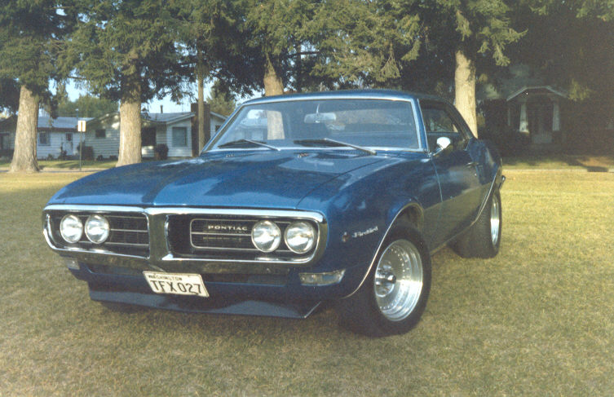

Slide 12
Power formula
P = W/T
P = power
W = work
T = time

Slide 13
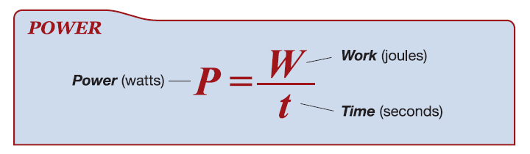

Slide 14
More work?
More power?

Slide 15
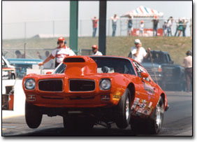
Example problem
A motor does 500 Joules of work in 5 seconds. How much power does the motor have?
given formula set up problem answer w/ unit of measurement
W= 500 J P=W/T 500 J / 5 sec. 100 watts
T= 5 sec.
J/s is the same as a watt

