Slide 1
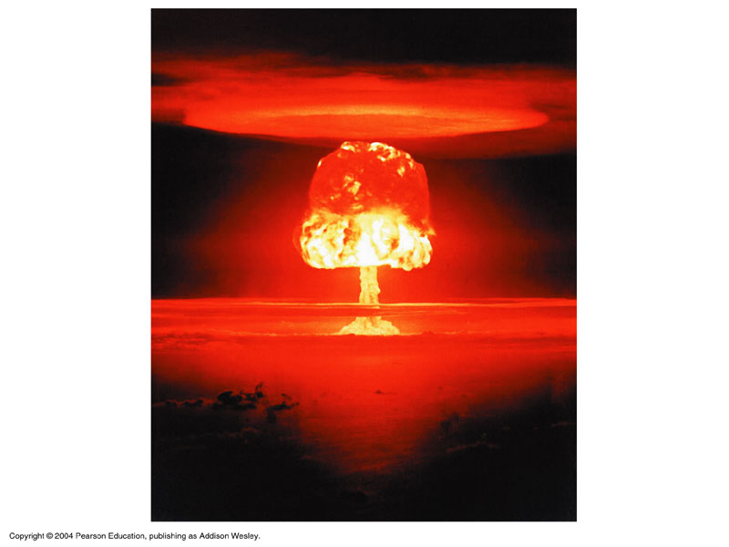
States, Forms, and Conservation of Energy
Road Runner- Energy (1:23)

Slide 2
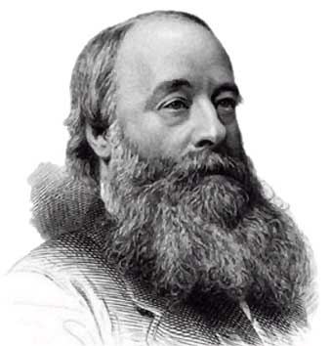
energy is the ability to do work
  unit of measurement is also the Joule (J)
  Kinetic and Potential Energy (1:55)

Slide 3
STATES of Energy
Kinetic Energy
  energy of motion
  a moving object has the ability to do work
    this depends on the object’s mass and velocity

Slide 4
Kinetic Energy formula
K.E. = m · v²
2
K.E. = Kinetic Energy
m = mass
v = velocity

Slide 6
Example problem
How much kinetic energy is in a 5 kg ball with a velocity of 7 m/s?
given formula set up problem answer w/ unit of measurement
m = 5kg KE= m · v² 5kg(7m/s)² 122.5 Joules
v = 7m/s 2 2
or kg(m/s)²

Slide 7
  Potential Energy
    stored energy
    objects can have energy (can do work) because of their Position or Make Up
      a stretched rubber band (P)
      a can of gasoline (MU)
      an object that is held up and can fall (P)

Slide 8
Gravitational Potential Energy Formula
gravitational PE = m · g · h
PE = Potential Energy
m = mass
g = acceleration due to gravity on earth (9.8 m/s²)
h = height

Slide 9
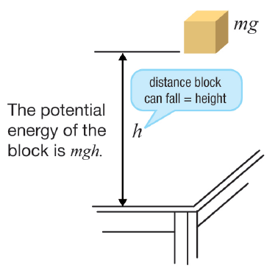
Potential Energy
mass of object (kg)
height object raised (m)
PE (joules)
E_{P} = mgh
gravity (9.8 m/sec²)
Slinky Falling YouTube (first 1:40)

Slide 10
Example problem
What is a gravitational potential energy of a 5 kg brick 4 meters high?
given formula set up problem answer w/ unit of measurement
m = 5kg PE= mgh 5kg · 9.8m/s² · 4m 196 Joules
g = 9.8m/s²
h = 4 m
or kg(m/s²)(m)

Slide 11
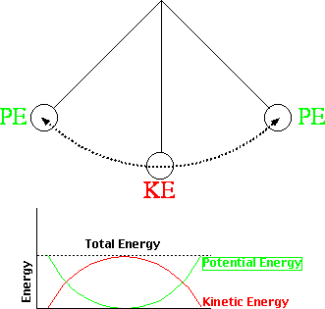

Slide 12
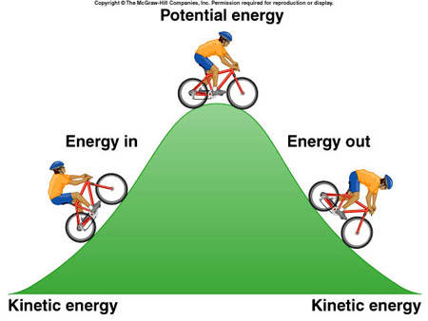

Slide 13
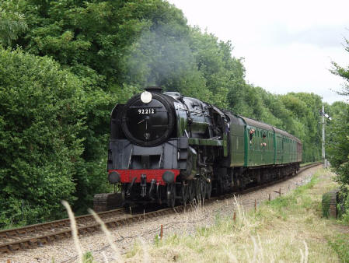
FORMS of Energy (these can be kinetic or potential)
Mechanical Energy
  energy possessed by an object that has to do with motion
Forms of Energy (1:59)

Slide 14
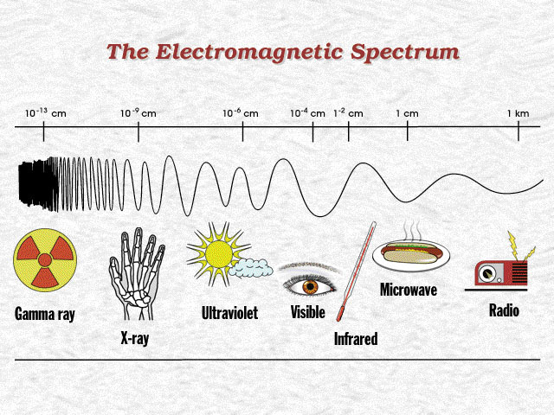
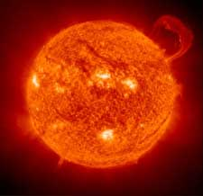
Radiant Energy
  carried by waves (micro, heat, UV, x-ray…)

Slide 15
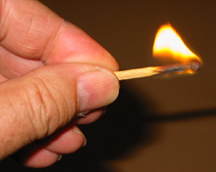
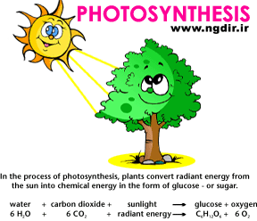
Chemical Energy
  energy stored in molecules
  can be released when the molecules are broken apart
    burning fuel, photosynthesis, digesting food…

Slide 16
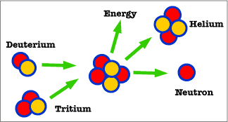
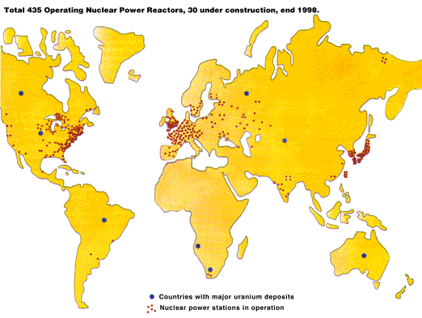
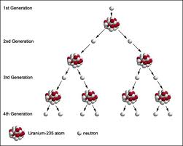
http://phet.colorado.edu/en/simulation/nuclear-fission
Nuclear Energy
  a very concentrated form of energy
  results when the nucleus of an atom splits (fisson) or two nuclei join (fusion)

Slide 17
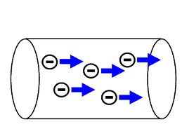
5. Electrical Energy
  energy from moving electrons

Slide 18

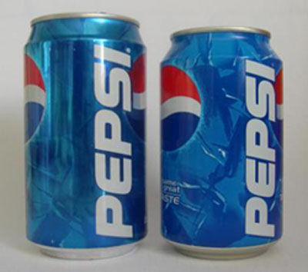

Slide 19

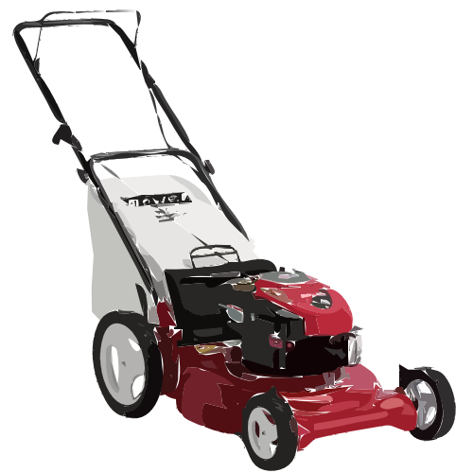

Slide 20
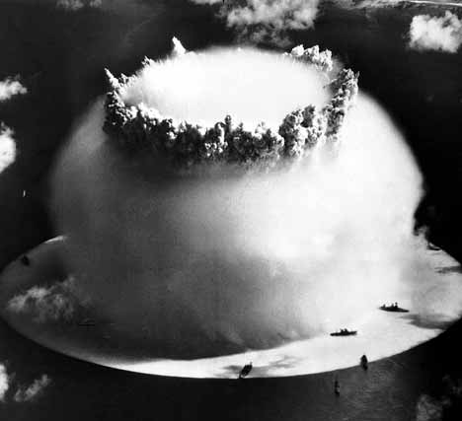
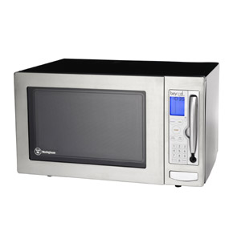

Slide 21
Law of Conservation of Energy
energy cannot be created nor destroyed by ordinary means
in a closed system, it is not “used up” but just converted to another form and therefore remains constant
we can never “run out” of energy
  however, may run out of the type we want the most

Slide 22
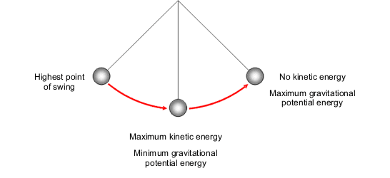
Converting Energy
all forms of energy can be converted to other forms
  sometimes simply PE to KE and back to PE
  or more complicated like mechanical, heat, chemical, electric, electromagnetic, and nuclear
    example: the chemical energy from the gas in a car changes into mechanical and radiant energy as the car moves.

Slide 23
What energy transformations must happen to light a light bulb?
  mechanical energy from the water in a river moves a turbine in a dam that makes…electrical energy in the light bulb that changes to…radiant energy and light energy that we can see and feel
  Law of Conservation of Energy video (1:41)
PE/KE Skate Park
Pendulum

