Slide 1
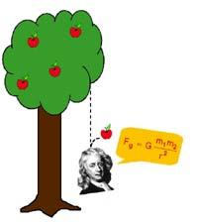
Gravity and Weight

Slide 2
Omar has the following:
  golf ball (70 grams)
  foam ball (30 grams)
  plastic ball (15 grams).
He holds them all exactly 2 meters off the ground and drops them at the exactly the same time.
In what order will they hit the ground?
  I. 1,2,3
  II. 3,2,1
  III. all at the same time

Slide 3
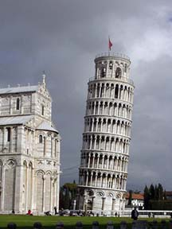
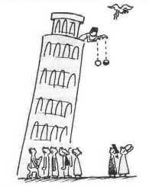
It is “said” that Galileo first dropped two cannonballs off the Leaning Tower of Pisa in Italy
  one was 10x heavier than the other
  they both hit the ground at the same time

Slide 4
http://www.youtube.com/watch?v=5C5_dOEyAfk
http://www.youtube.com/watch?v=_XJcZ-KoL9o&feature=related

Slide 5
Newton used Galileo’s research to conclude that objects accelerate downwards because of the force of gravity between the object and the earth
this acceleration is 9.8 m/s/s (or 9.8 m/s²) in a vacuum (no air)
however realistically, air resistance (fluid friction) often prevents many objects from accelerating this fast

Slide 6
Weight
a measure of gravity’s force on an object that is directly proportional to its mass
  this means gravity pulls more on objects that are bigger
weight can change depending on the force of gravity
  you weigh less on the moon than on the Earth because the moon has less gravity

Slide 7
Weight depends on mass and gravity

Slide 8
Weight formula
W = mg or W = m·g
or W = m ^{x} g or W = m(g)
W = Weight
m = mass
g = acceleration due to Earth’s gravity which is 9.8 m/s²

Slide 9
Example problem
What is the weight of a 50 kg person on Earth?
  on the moon, a=1.62 m/s² which would only be a weight of 81 N
given formula set up problem answer w/ unit of measurement
m=50 kg F=ma or
a=9.8 m/s² W=mg
50kg (9.8 m/s²)
490 N

Slide 10
Newton’s UNIVERSAL Law of Gravitational Attraction
all objects in the universe attract each other by the force of gravity
the size of this force depends on:
  the masses of the two objects
  the distance between them

Slide 11
Newton’s Universal Law of Gravitational Attraction
F_{g} = G ( )
m₁ · m₂
d²
F_{g} = Force of gravity
m₁ = mass of first object
m₂ = mass of second object
d = distance between objects
G = universal gravitational constant
6.67 x 10⁻¹¹ or .0000000000667

Slide 12
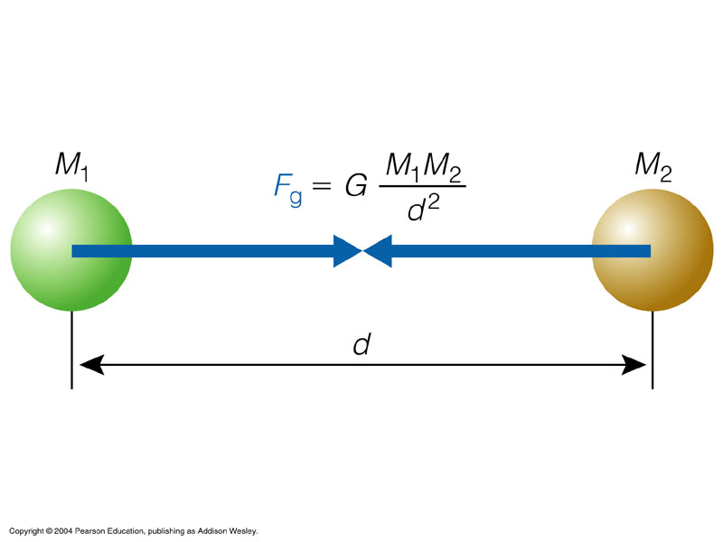

Slide 13
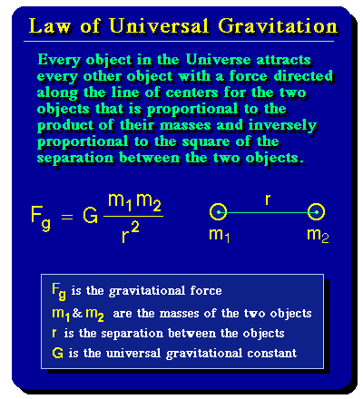

Slide 14
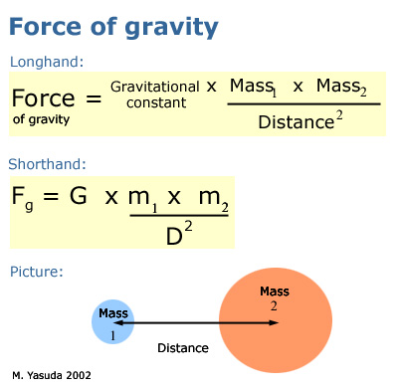

Slide 15
Example problem
A rock has a mass of 125 kg and another rock 5 meters away has a mass of 250 kg. What is the gravitational force between the two rocks?
given formula set up problem answer w/ unit of measurement
m₁=125kg F=G m₁m₂
m₂=250kg d²
d=5m
8.3 x 10⁻⁸ N
or
0.000000083N
G x 125(250)
5²

