Slide 1
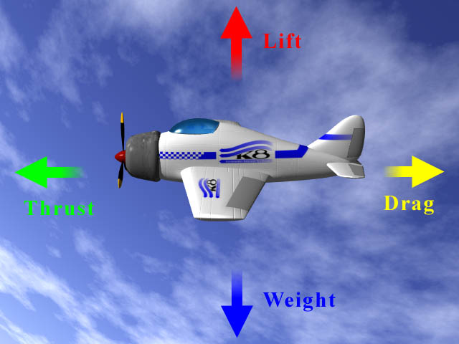
Force

Slide 2
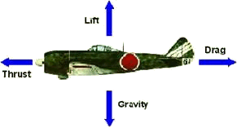

Slide 3
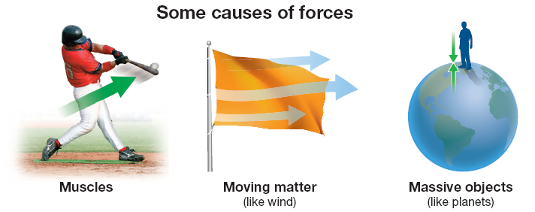
a push or a pull
  the action that has the ability to change motion
a force gives energy to an object causing it to…
  start moving, stop moving, or change direction
to predict the effect of a force, you need to know both its strength AND its direction
  use vectors for this

Slide 4
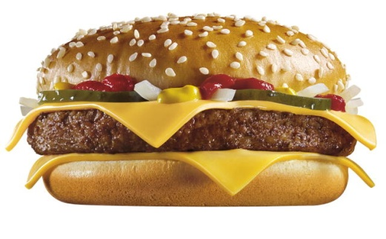
the unit of measurement is Newtons (N)
  used to be a kg(m/s²)
  this is about ¼ pound
BTW - meat only
Get out scales!

Slide 5
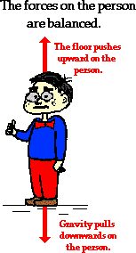


5000 N Wall ----> <---- Tractor 5000 N
5000 N Wall ----> <---- Tractor 7000 N

Slide 6
forces in the same direction are added to make the resulting force stronger
forces in different directions are subtracted which makes the resulting force weaker
  the sum of all the forces on an object is called the net force or resultant force
    if forces are equal and opposite, they are balanced and the net force on the object is zero
      the object is in equilibrium (it is NOT accelerating)
    if the forces are not equal, this will cause an object to accelerate or change direction

Slide 7
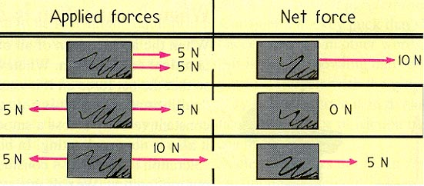
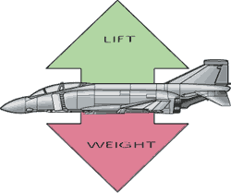
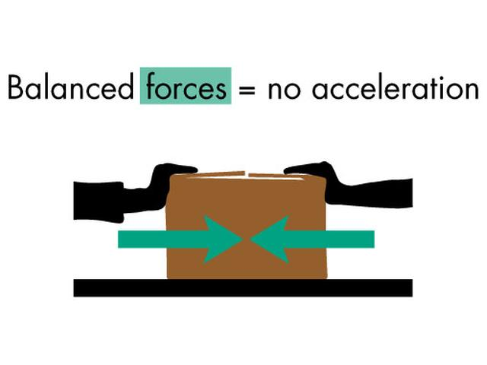
Balancing Nails, Belt, Boring Date Trick

Slide 8
Physics of Skydiving video (3:06)

Slide 9
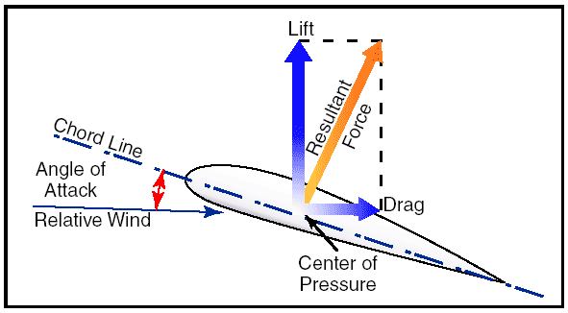

Slide 10
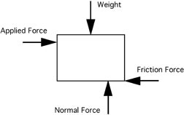

Slide 11
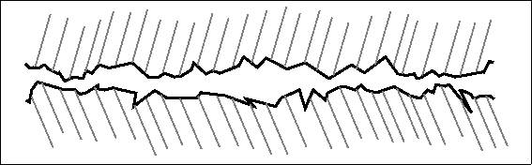
Types of Forces
Contact Forces: the objects involved are touching each other and friction is created
  friction is a force that is in the opposite direction to the moving object and therefore, slows it down
  the greater the force squeezing the two surfaces together, the greater the fricton
http://phet.colorado.edu/en/simulation/friction

Slide 12
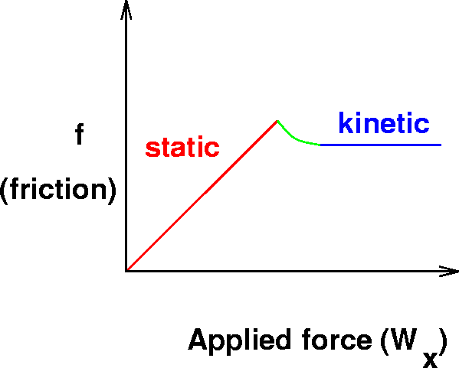
Static and Kinectic Friction

Slide 13
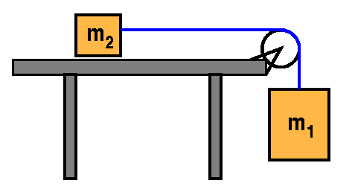
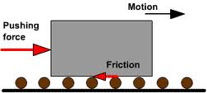
  4 types of friction
    static – keeps object at rest
    kinetic – causes objects to stop
    rolling
    fluid – this is caused by an
    object moving through a
    liquid OR a gas
Curling video
1:31

Slide 14
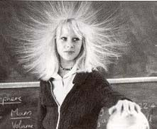
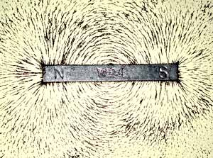
Non-contact, force field, or “at a distance” forces: objects are pushed or pulled without being touched
  gravity
  electrical
  magnetic

